Slide 1
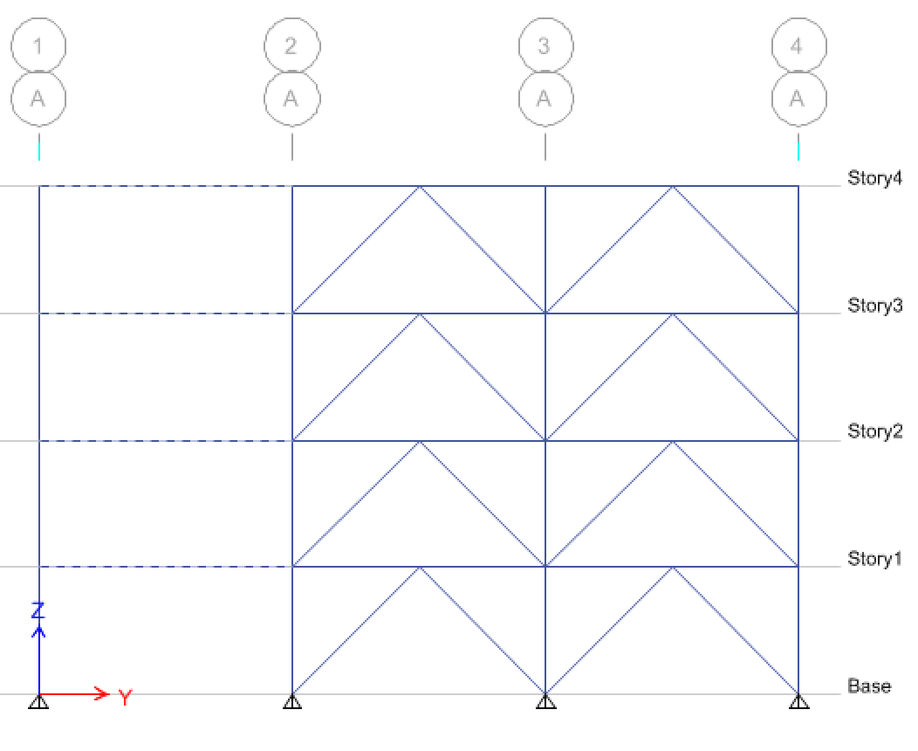
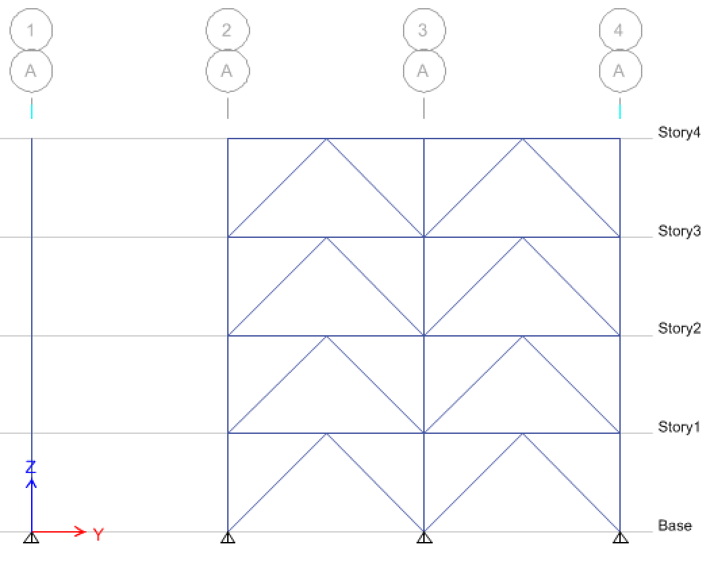
Acceptable: Infill beams exist to brace column on Gridline A
Unacceptable: Column unbraced at each floor

